Slide 1
CS 547
JavaScript Frameworks
jQuery
Week 14 Day 2

Slide 2
Agenda
jQuery

Slide 3
Pillow on Mac
More students are reporting issues on mac
use homebrew to install python 3
use pip3 to install Pillow

Slide 4
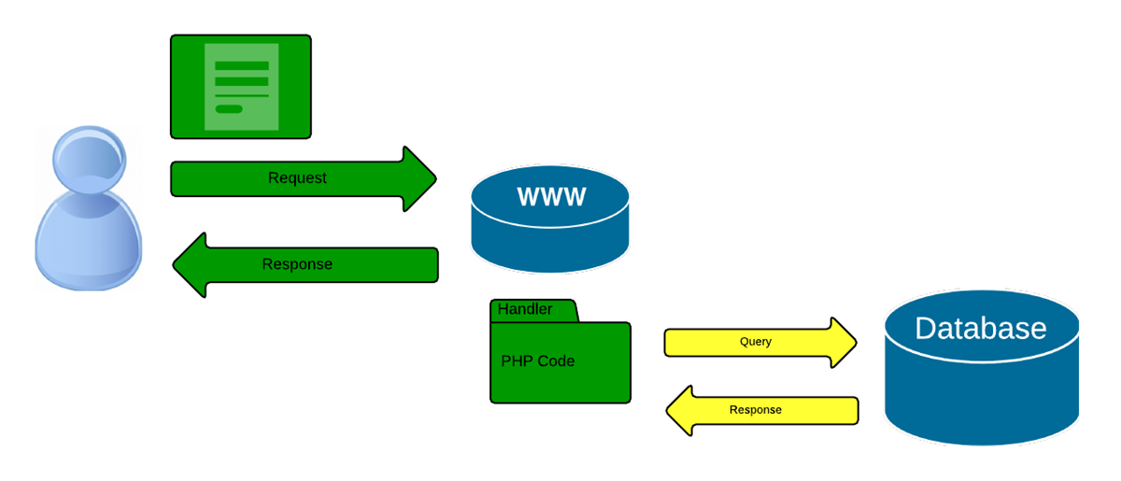

JS Frameworks:

Slide 5
JS Frameworks

Slide 6
Frameworks
Frameworks are libraries written for the purpose of making some task easier.
One can manipulate the DOM directly, but it is easier to use a framework such as jQuery.

Slide 7
Using jQuery
Since jQuery is a library, you can include it in your web pages:
Locally:
<script src = “jquery.js”></script>
via CDN:
<script src = “//code.jquery.com/jquery-2.1.3.min.js”></script>

Slide 8
Using jQuery
There are two usage styles for jQuery:
Command:
via the $ function, ( factory method) chainable and return a jQuery object
Utility:
via the $.-prefixed function. These do not act on the jQuery object directly

Slide 9
Using jQuery
<script>
$(document).ready(function(){
// jQuery methods go here...
</script>

Slide 10
Using jQuery
<script>
$(document).ready(function(){
// jQuery methods go here...
</script>

Slide 11
jQuery: Element Selector
<div id ="myDiv">
<p> First Paragraph </p>
<input id="mybutton" type="button" onclick="myClick();" value="Click here">
<p> Second Paragraph </p>
<button>Click me</button>
</div>
<script>
$(document).ready(function(){
$("button").click(function(){
$("p").hide(); });
$("#mybutton").click(function(){
$("p").show(); });
});
</script>

Slide 12
jQuery: #id Selector
<div id ="myDiv">
<p> First Paragraph </p>
<input id="mybutton" type="button" onclick="myClick();" value="Click here">
<p> Second Paragraph </p>
<button>Click me</button>
</div>
<script>
$(document).ready(function(){
$("button").click(function(){
$("p").hide(); });
$("#mybutton").click(function(){
$("p").show(); });
});
</script>

Slide 13
jQuery: class Selector
<div id ="myDiv">
<p class="myClass"> First Paragraph </p>
<input id="mybutton" type="button" onclick="myClick();" value="Click here">
<p> Second Paragraph </p>
<button>Click me</button><input id="mySpecialbutton" type="button" value="Click to hide myClass">
…
$("button").click(function(){
$("p").hide(); });
$("#mybutton").click(function(){
$("p").show(); })
$("#mySpecialbutton").click(function(){
$(".myClass").hide(); });
});
</script>

Slide 14
jQuery Selectors
Syntax | Description
$("*") | Selects all elements
$(this) | Selects the current HTML element
$("p.intro") | Selects all <p> elements with class="intro"
$("p:first") | Selects the first <p> element
$("ul li:first") | Selects the first <li> element of the first <ul>
$("ul li:first-child") | Selects the first <li> element of every <ul>
$("[href]") | Selects all elements with an href attribute
$("a[target='_blank']") | Selects all <a> elements with a target attribute value equal to "_blank"
$("a[target!='_blank']") | Selects all <a> elements with a target attribute value NOT equal to "_blank"
$(":button") | Selects all <button> elements and <input> elements of type="button"
$("tr:even") | Selects all even <tr> elements
$("tr:odd") | Selects all odd <tr> elements

Slide 15
jQuery Events
Mouse Events | Keyboard Events | Form Events | Document/Window Events
click | keypress | submit | load
dblclick | keydown | change | resize
mouseenter | keyup | focus | scroll
mouseleave |  | blur | unload

Slide 16
jQuery Events Syntax
In jQuery, most DOM events have an equivalent jQuery method.
1. assign a click event
$("p").click();
2. define what should happen when the event fires. You must pass a function to the event:
$("p").click( function(){
// action goes here!!
});

Slide 17
jQuery Effects
jQuery offers convenience methods for most native browser events.
These methods — including .click(), .focus(), .blur(), .change(), etc. — are shorthand for jQuery's .on() method.
Note the .on() can only create event listeners on elements that exist at the time you set up the listeners. Similar elements created after the event listeners are established will not automatically pick up event behaviors you've set up previously.

Slide 18
jQuery Effects
In jQuery, effects are actions that your webpage can do or respond to .
Can be based on
user actions – text entered in a field
other events – mouse or clicks
browser itself – page load or unload

Slide 19
jQuery: class Selector
<div id ="myDiv">
<input id="myFadebutton" type="button" value="Click to fade this div myClass">
<div id="div1" style="width:80px;height:80px;display:none;background-color:red;"></div><br>
…
$("button").click(function(){
$("p").hide(); });
$("#mybutton").click(function(){
$("p").show(); })
$("#mySpecialbutton").click(function(){
$(".myClass").hide(); });
$("#myFadebutton").click(function(){
$("#div1").fadeIn(3000); });
});
</script>

Slide 20
jQuery Effects
Method | Description
animate() | Runs a custom animation on the selected elements
clearQueue() | Removes all remaining queued functions from the selected elements
delay() | Sets a delay for all queued functions on the selected elements
dequeue() | Removes the next function from the queue, and then executes the function
fadeIn() | Fades in the selected elements
fadeOut() | Fades out the selected elements
fadeTo() | Fades in/out the selected elements to a given opacity
fadeToggle() | Toggles between the fadeIn() and fadeOut() methods

Slide 21
jQuery Effects
Method | Description
finish() | Stops, removes and completes all queued animations for the selected elements
hide() | Hides the selected elements
queue() | Shows the queued functions on the selected elements
show() | Shows the selected elements
slideDown() | Slides-down (shows) the selected elements
slideToggle() | Toggles between the slideUp() and slideDown() methods
slideUp() | Slides-up (hides) the selected elements
stop() | Stops the currently running animation for the selected elements
toggle() | Toggles between the hide() and show() methods

Slide 22
jQuery HTML
jQuery is used to manipulate and interact with the DOM or the html page. Three important methods are:
text() - Sets or returns the text content of selected elements
html() - Sets or returns the content of selected elements (including HTML markup)
val() - Sets or returns the value of form fields

Slide 23
jQuery HTML
Get Context:
$("#test").text()); // gets the text of the test element
$("#test").html()); // gets the html code from the test element
$("#test").val()); // returns the value of an input element

Slide 24
jQuery HTML
the same three methods from before are used to set content:
text() - Sets or returns the text content of selected elements
html() - Sets or returns the content of selected elements (including HTML markup)
val() - Sets or returns the value of form fields

Slide 25
jQuery HTML
Set Context:
$("#test").text(“some text”)); // sets test element to some text
$("#test").html(“some html”)); // sets test element to some html
$("#test").val(“a value”)); // sets the value of an input element

Slide 26
jQuery Add to HTML
There are four jQuery methods that are used to add new content:
append() - Inserts content at the end of the selected elements
prepend() - Inserts content at the beginning of the selected elements
after() - Inserts content after the selected elements
before() - Inserts content before the selected elements

Slide 27
jQuery New HTML
There are three ways of creating new HTML elements:
1. using html – var txt1 = "<p>Text.</p>";
2. using jQuery – var txt2 = $("<p></p>").text("Text.");
3. using DOM – txt3 = document.createElement("p");

Slide 28
jQuery Removing HTML
There are two jQuery methods to remove elements
remove() - Removes the selected element (and its child elements)
empty() - Removes the child elements from the selected element

Slide 29
jQuery Validating forms
You can use several plugins to validate form data with jQuery
Search the jQuery plugin site http://plugins.jquery.com/ for validators.

